Slide 1
Classification and Prediction
UNIT-5

Slide 2
Classification and Prediction
What is classification? What is prediction?
Issues regarding classification and prediction
Classification by decision tree induction
Bayesian Classification
Classification by backpropagation
Classification based on concepts from association rule mining
Other Classification Methods
Prediction
Classification accuracy
Summary

Slide 3
Databases are rich with hidden information that can be used for making intelligent business decisions.
Classification and Prediction are two forms of data analysis that can be used to extract models describing important data classes or to predict future data trends.
Classification predicts categorical labels, prediction models continuous valued functions
For ex, a classification model may be built to categorize bank loan applications as either safe or risky, while predication model may be built to predict the expenditures of potential customers on computer equipment given their income and occupation.
Many classification and prediction methods have been proposed by researchers in machine learning, expert systems, statistics and neurobiology.

Slide 4
What is Classification ? What is Prediction
Data classification : It is a two step process.
In the first step, a model is built describing a predetermined step of data classes or concepts.
The model is constructed by analyzing database tuples described by attributes.
Each tuple is assumed to belong to a predefined class as determined by one of the attributes, called the class label attribute.

Slide 5
In the context of classification, data tuples are also referred to as samples, examples or objects.
The data tuples analyzed to build the model collectively form the training data set
The individual tuples making up the training set are referred to as training samples and are randomly selected from the sample population

Slide 6
Since the class label of each training sample is provided, this step is also known as supervised learning (i.e., the learning of the model is “supervised” in that it is told to which each training sample belongs)
It contrasts with unsupervised learning (or clustering), in which the class label of each training sample is not known, and the number or set of classes to be learned may be known in advanced.
Typically, the learned model is represented in the form of classification rules, decision trees, or mathematical formulae.
For example, given a database of customer credit information, classification rules can be learned to identify customers having either excellent or fair credit ratings.
The rules can be used to categorize future data samples, as well as provide a better understanding of the database contents.

Slide 7



Classification Process (1): Model Construction
Classification
Algorithms
Training
Data
Classifier
(Model)
IF rank = ‘professor’
OR years > 6
THEN tenured = ‘yes’

Slide 8
Supervised learning (classification)
  Supervision: The training data (observations, measurements, etc.) are accompanied by labels indicating the class of the observations
  New data is classified based on the training set
Unsupervised learning (clustering)
  The class labels of training data is unknown
  Given a set of measurements, observations, etc. with the aim of establishing the existence of classes or clusters in the data

Slide 9
In the second step, the model is used for classification.
First the predictive accuracy of the model (or classifier) is estimated. Coming slides we will discuss several methods for estimating classifier accuracy.
The Holdout Method is a simple technique that uses a test set of class labeled samples.
These samples are randomly selected and are independent of training samples.
The Accuracy of a model on a given test set is the percentage of test set samples that are correctly classified by the model.
For each test sample, the known class label is compared with the learned model’s class prediction for that sample.
If the accuracy of model is considered acceptable, the model can be used to classify future data tuples or objects for which the class label is known.
(Such data are also referred to in the machine learning literature as “unknown” or “previously unseen” data)

Slide 10
For example, the classification rules learned in Fig a from the analysis of data from existing customers can be used to predict the credit rating of new or future (i.e. previously unseen) customers.
“How is predication different from classification” Predication can be viewed as the construction and use of a model to assess the class of an unlabeled sample, or to assess the value or value ranges of an attribute that a given sample is likely to have

Slide 11




Classification Process (2): Use the Model in Prediction
Classifier
Testing
Data
Unseen Data
(Jeff, Professor, 4)
Tenured?

Slide 12
Classification vs. Prediction
Classification:
  predicts categorical class labels
  classifies data (constructs a model) based on the training set and the values (class labels) in a classifying attribute and uses it in classifying new data
Prediction:
  models continuous-valued functions, i.e., predicts unknown or missing values
Typical Applications
  credit approval
  target marketing
  medical diagnosis
  treatment effectiveness analysis

Slide 13
Classification— A Two-Step Process
Model construction: describing a set of predetermined classes
  Each tuple/sample is assumed to belong to a predefined class, as determined by the class label attribute
  The set of tuples used for model construction: training set
  The model is represented as classification rules, decision trees, or mathematical formulae
Model usage: for classifying future or unknown objects
  Estimate accuracy of the model
    The known label of test sample is compared with the classified result from the model
    Accuracy rate is the percentage of test set samples that are correctly classified by the model
    Test set is independent of training set, otherwise over-fitting will occur

Slide 14
Classification Process (1): Model Construction
Classification
Algorithms
Training
Data
Classifier
(Model)
IF rank = ‘professor’
OR years > 6
THEN tenured = ‘yes’

Slide 15
Classification Process (2): Use the Model in Prediction
Classifier
Testing
Data
Unseen Data
(Jeff, Professor, 4)
Tenured?

Slide 16
Supervised vs. Unsupervised Learning
Supervised learning (classification)
  Supervision: The training data (observations, measurements, etc.) are accompanied by labels indicating the class of the observations
  New data is classified based on the training set
Unsupervised learning (clustering)
  The class labels of training data is unknown
  Given a set of measurements, observations, etc. with the aim of establishing the existence of classes or clusters in the data

Slide 17
Classification and Prediction
What is classification? What is prediction?
Issues regarding classification and prediction
Classification by decision tree induction
Bayesian Classification
Classification by backpropagation
Classification based on concepts from association rule mining
Other Classification Methods
Prediction
Classification accuracy
Summary

Slide 18
Issues regarding classification and prediction
Preparing the Data for Classification and Prediction
Data cleaning
  This refers to the preprocessing of data in order to remove or reduce noise (by applying smoothing techniques, for ex) and the treatment of missing values (e.g. by replacing the missing values with the most commonly occurring value for the most probable value based on statistics). Although most classification algorithms have some mechanisms for handling noisy or missing data, this step can help reduce confusion during learning
Relevance Analysis
  Many of the attributes in the data may be irrelevant to the classification or prediction task. For ex, data recording the day of the week on which a bank loan application was filed is unlikely to be relevant to the success of the application. Furthermore, other attributes may be redundant. Hence, relevance analysis may be performed on the data with the aim to removing any irrelevant or redundant attributes from the learning process. In machine learning, this step is known as feature selection. Including such attributes may other wise slow down, and possibly mislead, the learning step

Slide 19
Data Transformation
  The data can be generalized to higher – level concepts. Concept hierarchies may be used for this purpose. This is particularly useful for continuous-valued attributes. For ex, numeric values for the attribute income may be generalized to discrete ranges such as low, medium and high. Similarly, nominal-valued attributes, like street, can be generalized to higher level concepts, like city. Since generalization compresses the original training data, fewer input/output operations may be involved during learning
  The data may be normalized, particularly when neural networks or methods involving distance measurements, are used in the learning step. Normalization involves scaling all values for a given attribute so that they fall within a small specified range, such as -1.0 to 1.0 or 0.0 to 1.0. In methods that use distance measurements, for ex, this would prevent attributes with initially large ranges (like, say income) from outweighing attributes with initially smaller ranges Such as binary attributes.

Slide 20
Comparing Classification Methods
Classification and prediction methods can be compared and evaluated according to the following criteria
Predictive Accuracy : This refers to the ability of the model to correctly predict the class label of new or previously unseen data
Speed : This refers to the computation costs involved in generating and using the model
Robustness : This is the ability of the model to make correct predictions given noisy data or data with missing values.
Scalability : This refers to the ability to construct the model efficiently given large amounts of data.
Interpretability : This refers to the level of understanding and insight that is provided by the model.

Slide 21
Classification and Prediction
What is classification? What is prediction?
Issues regarding classification and prediction
Classification by decision tree induction
Bayesian Classification
Classification by back propagation
Classification based on concepts from association rule mining
Other Classification Methods
Prediction
Classification accuracy
Summary

Slide 22
Classification by Decision Tree Induction
Decision tree
  A flow-chart-like tree structure
  Internal node denotes a test on an attribute
  Branch represents an outcome of the test
  Leaf nodes represent class labels or class distribution
Decision tree generation consists of two phases
  Tree construction
    At start, all the training examples are at the root
    Partition examples recursively based on selected attributes
  Tree pruning
    Identify and remove branches that reflect noise or outliers
Use of decision tree: Classifying an unknown sample
  Test the attribute values of the sample against the decision tree

Slide 23
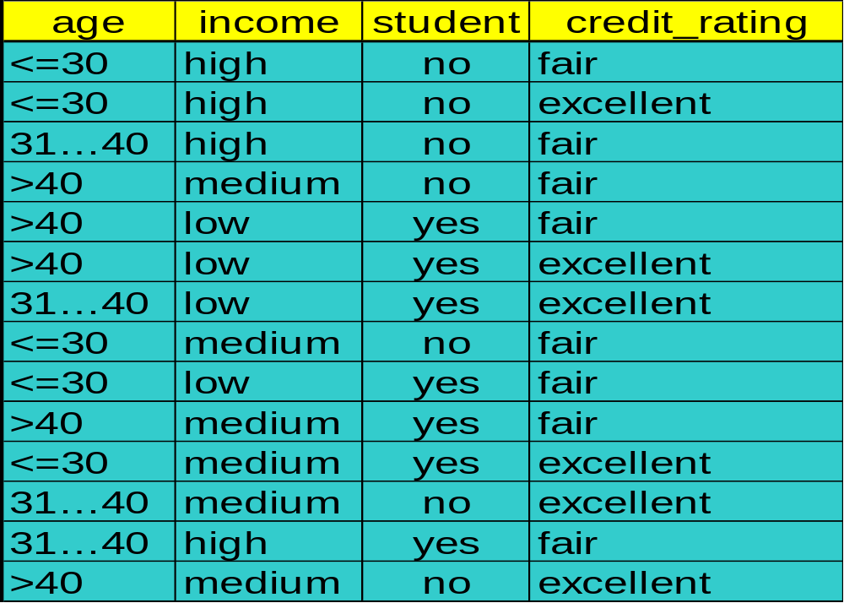
Training Dataset
This follows an example from Quinlan’s ID3

Slide 24
Output: A Decision Tree for “buys_computer”
age?
<=30
overcast
>40
30..40
student?
yes
credit rating?
no
yes
excellent
fair
no
yes
no
yes

Slide 25
Algorithm for Decision Tree Induction
Basic algorithm (a greedy algorithm)
  Tree is constructed in a top-down recursive divide-and-conquer manner
  At start, all the training examples are at the root
  Attributes are categorical (if continuous-valued, they are discretized in advance)
  Examples are partitioned recursively based on selected attributes
  Test attributes are selected on the basis of a heuristic or statistical measure (e.g., information gain)
Conditions for stopping partitioning
  All samples for a given node belong to the same class
  There are no remaining attributes for further partitioning – majority voting is employed for classifying the leaf
  There are no samples left

Slide 26
Attribute Selection Measure
Information gain (ID3/C4.5)
  All attributes are assumed to be categorical
  Can be modified for continuous-valued attributes
Gini index (IBM IntelligentMiner)
  All attributes are assumed continuous-valued
  Assume there exist several possible split values for each attribute
  May need other tools, such as clustering, to get the possible split values
  Can be modified for categorical attributes

Slide 27
RID | Age | Income | Student | Credit_rating | Class : Buys_computer
1 2 3 4 5 6 7 8 9 10 11 12 13 14 | =30 <=30 31.40 >40 >40 >40 31.40 <=30 <=30 >40 <=30 31.40 31.40 >40 | High High High Medium Low Low Low Medium Low Medium Medium Medium High Medium | No No No No Yes Yes Yes No Yes Yes Yes No Yes No | Fair Excellent Fair Fair Fair Excellent Excellent Fair Fair Fair Excellent Excellent Fair Excellent | No No Yes Yes Yes No Yes No Yes Yes Yes Yes Yes No

Slide 28
Information Gain (ID3/C4.5)
Select the attribute with the highest information gain
Assume there are two classes, P and N
  Let the set of examples S contain p elements of class P and n elements of class N
  The amount of information, needed to decide if an arbitrary example in S belongs to P or N is defined as

Slide 29
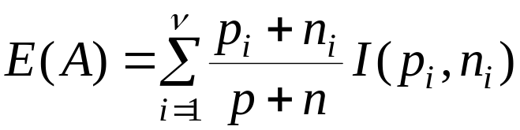

Information Gain in Decision Tree Induction
Assume that using attribute A a set S will be partitioned into sets {S₁, S₂ , …, S_{v}}
  If S_{i} contains p_{i} examples of P and n_{i} examples of N, the entropy, or the expected information needed to classify objects in all subtrees S_{i} is
The encoding information that would be gained by branching on A

Slide 30
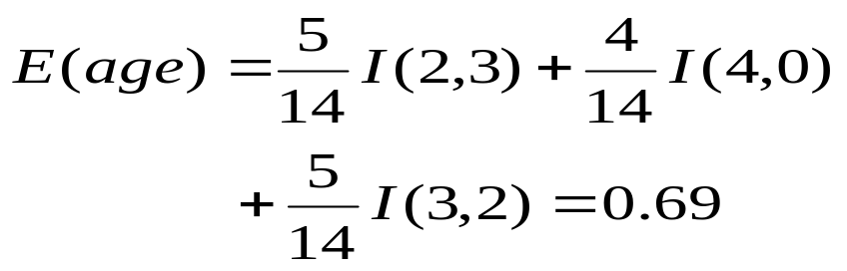


Attribute Selection by Information Gain Computation
Class P: buys_computer = “yes”
Class N: buys_computer = “no”
I(p, n) = I(9, 5) =0.940
Compute the entropy for age:
Hence
Similarly

Slide 31
To compute the information gain of each attribute
I (S1,S2) = I(9,5)
= -9/14 log 9/14 – 5/14 log 5/14
= -9/14 log₁₀ (9/14) - 5/14 log₁₀ (5/14) -
log₂ (2) log₂ (2)
= .6428 * .6374 + .3571 * 1.4854
= 0.4097 + 0.5304
= 0.9401

Slide 32
Extracting Classification Rules from Trees
Represent the knowledge in the form of IF-THEN rules
One rule is created for each path from the root to a leaf
Each attribute-value pair along a path forms a conjunction
The leaf node holds the class prediction
Rules are easier for humans to understand
Example
  IF age = “<=30” AND student = “no” THEN buys_computer = “no”
  IF age = “<=30” AND student = “yes” THEN buys_computer = “yes”
  IF age = “31…40” THEN buys_computer = “yes”
  IF age = “>40” AND credit_rating = “excellent” THEN buys_computer = “yes”
  IF age = “>40” AND credit_rating = “fair” THEN buys_computer = “no”

Slide 33
Avoid Overfitting in Classification
The generated tree may overfit the training data
  Too many branches, some may reflect anomalies due to noise or outliers
  Result is in poor accuracy for unseen samples
Two approaches to avoid overfitting
  Prepruning: Halt tree construction early—do not split a node if this would result in the goodness measure falling below a threshold
    Difficult to choose an appropriate threshold
  Postpruning: Remove branches from a “fully grown” tree—get a sequence of progressively pruned trees
    Use a set of data different from the training data to decide which is the “best pruned tree”

Slide 34
Enhancements to basic decision tree induction
Allow for continuous-valued attributes
  Dynamically define new discrete-valued attributes that partition the continuous attribute value into a discrete set of intervals
Handle missing attribute values
  Assign the most common value of the attribute
  Assign probability to each of the possible values
Attribute construction
  Create new attributes based on existing ones that are sparsely represented
  This reduces fragmentation
  Repetition- occurs when an attribute is repeatedly tested along a given branch of the tree.
  Replication- duplicate sub trees exist within the tree. It can impede the accuracy and comprehensibility of the resulting tree.

Slide 35
Classification in Large Databases
Classification—a classical problem extensively studied by statisticians and machine learning researchers
Scalability: Classifying data sets with millions of examples and hundreds of attributes with reasonable speed
Why decision tree induction in data mining?
  relatively faster learning speed (than other classification methods)
  convertible to simple and easy to understand classification rules
  can use SQL queries for accessing databases
  comparable classification accuracy with other methods

Slide 36
Scalable Decision Tree Induction Methods in Data Mining Studies
SLIQ (EDBT’96 — Mehta et al.)
  builds an index for each attribute and only class list and the current attribute list reside in memory
SPRINT (VLDB’96 — J. Shafer et al.)
  constructs an attribute list data structure
PUBLIC (VLDB’98 — Rastogi & Shim)
  integrates tree splitting and tree pruning: stop growing the tree earlier
RainForest (VLDB’98 — Gehrke, Ramakrishnan & Ganti)
  separates the scalability aspects from the criteria that determine the quality of the tree
  builds an AVC-list (attribute, value, class label)

Slide 37
Classification and Prediction
What is classification? What is prediction?
Issues regarding classification and prediction
Classification by decision tree induction
Bayesian Classification
Classification by backpropagation
Classification based on concepts from association rule mining
Other Classification Methods
Prediction
Classification accuracy
Summary

Slide 38
Bayesian Classification: Why?
“What are Bayesian Classifiers?” :
Bayesian Classifiers are statistical classifiers. They can predict class membership probabilities, such as the probability that a given sample belongs to a particular class.
Bayesian classification is based on Bayes theorem. Studies comparing classification algorithms have found a simple Bayesian classifier known as the naïve Bayesian classifier to be comparable in performance with decision tree and neural network classifier.

Slide 39
Bayesian Classification(contd..)
Let X be a data tuple. Where X is considered “evidence.”
Let H be some hypothesis, such as that the data tuple X belongs to a specified class C.
For classification problems, we want to determine P(H/X), the probability that the hypothesis H holds given the “evidence” or observed data tuple X.
(we are looking for the probability that tuple X belongs to class C, given that we know the attribute description of X)
P(H/X) is the posterior probability, or a posteriori probability, of H conditioned on X.

Slide 40
For example, suppose our world of data tuples is confined to customers described by the attributes age and income, respectively, and that X is a 35-year-old customer with an income of $40,000.
Suppose that H is the hypothesis that our customer will buy a computer.
P(H/X) reflects the probability that customer X will buy a computer given that we know the customer’s age and income.
P(H) is the prior probability, or a priori probability, of H. For our example, this is the probability that any given customer will buy a computer, regardless of age or income.
P(X/H) is the posterior probability of X conditioned on H. That is, it is the probability that a customer, X, is 35 years old and earns $40,000, given that we know the customer will buy a computer.

Slide 41

Bayesian Theorem
Given training data X, posteriori probability of a hypothesis H, P(H|X) follows the Bayes theorem
Practical difficulty: require initial knowledge of many probabilities, significant computational cost

Slide 42
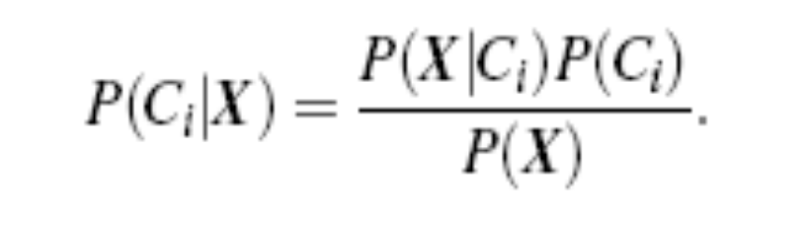
The naïve Bayesian classifier(simple Bayesian classifier) works as follows:
1. Let D be a training set of tuples and their associated class labels. As usual, each tuple is represented by an n-dimensional attribute vector, X = (x1, x2, : : : , xn), depicting n measurements made on the tuple from n attributes, respectively, A1, A2, : : : , An.
2. Suppose that there are m classes, C1, C2, : : : , Cm. Given a tuple, X, the classifier will predict that X belongs to the class having the highest posterior probability, conditioned on X.

Slide 43

3. As P(X) is constant for all classes, only P(X/Ci)P(Ci) need be maximized. If the class prior probabilities are not known, then it is commonly assumed that the classes are equally likely, that is, P(C1) = P(C2) = …… = P(Cm), and we would therefore maximize P(X/Ci).
4. Given data sets with many attributes, it would be extremely computationally expensive to compute P(X/Ci).

Slide 44
5. In order to predict the class label of X, P(X/Ci)P(Ci) is evaluated for each class Ci. The classifier predicts that the class label of tuple X is the class Ci if and only if

Slide 45
Naïve Bayesian Classification
Naïve assumption: attribute independence
P(x1,…,xk|C) = P(x1|C)·…·P(xk|C)
If i-th attribute is categorical:
P(xi|C) is estimated as the relative freq of samples having value xi as i-th attribute in class C
If i-th attribute is continuous:
P(xi|C) is estimated thru a Gaussian density function
Computationally easy in both cases

Slide 46
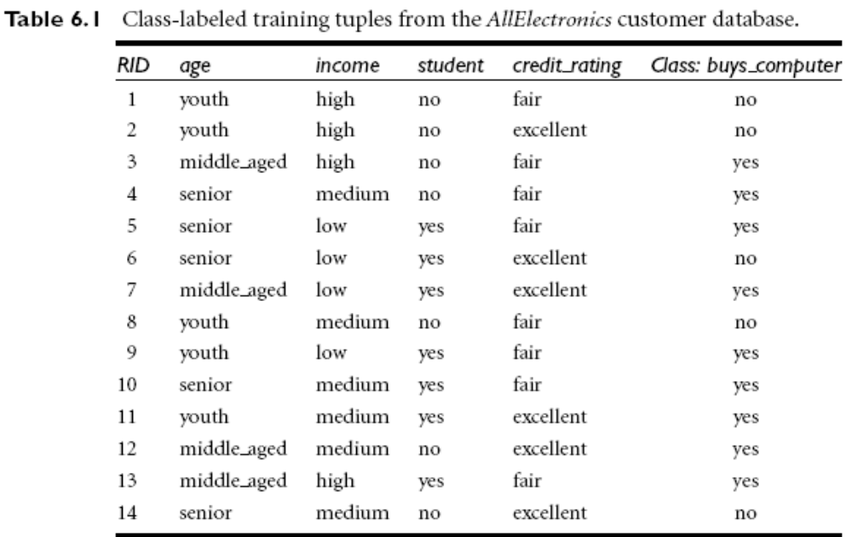

Slide 47
Example: Predicting a class label using naïve Bayesian classification.
We wish to predict the class label of a tuple using naïve Bayesian classification. The training data are in Table 6.1.
The data tuples are described by the attributes age, income, student, and credit rating. The class label attribute, buys computer, has two distinct values (namely, {yes, no}).
Let C1 correspond to the class buys computer = yes and C2 correspond to buys computer = no.
The tuple we wish to classify is
X = (age = youth, income = medium, student = yes, credit rating = fair)

Slide 48
We need to maximize P(X/Ci)P(Ci), for i = 1, 2. P(Ci), the prior probability of each class, can be computed based on the training tuples:
P(buys computer = yes) = 9=14 = 0:643
P(buys computer = no) = 5=14 = 0:357
To compute PX/Ci), for i = 1, 2, we compute the following conditional probabilities:

Slide 49
P(age = youth / buys computer = yes) = 2/9 = 0:222
P(age = youth / buys computer = no) = 3/5 = 0:600
P(income = medium / buys computer = yes) = 4/9 = 0:444
P(income = medium / buys computer = no) = 2/5 = 0:400
P(student = yes / buys computer = yes) = 6/9 = 0:667
P(student = yes / buys computer = no) = 1/5 = 0:200
P(credit rating = fair / buys computer = yes) = 6/9 = 0:667
P(credit rating = fair / buys computer = no) = 2/5 = 0:400

Slide 50
Using the above probabilities, we obtain
P(X/buys computer = yes) =
P(age = youth / buys computer = yes) x
P(income = medium / buys computer = yes) x
P(student = yes / buys computer = yes) x
P(credit rating = fair / buys computer = yes)
= 0.222 x 0.444 x 0.667 x 0.667 = 0:044.
Similarly,
P(X/buys computer = no) = 0.600 x 0.400 x 0.200 x 0.400 =0.019.

Slide 51
To find the class, Ci, that maximizes P(XjCi)P(Ci), we compute
P(X/buys_computer = yes)P(buys_computer = yes)
= 0.044 x 0.643 = 0.028
P(X/buys_computer = no)P(buys_computer = no)
  = 0:0190:357 = 0:007
Therefore, the naïve Bayesian classifier predicts buys_computer = yes for tuple X.

Slide 52
Bayesian Belief Networks (I)
Family
History
Smoker
(FH, S)
(FH, ~S)
(~FH, S)
(~FH, ~S)
LC
0.8
0.5
0.7
0.1
LungCancer
Emphysema
~LC
0.2
0.5
0.3
0.9
The conditional probability table for the variable LungCancer
PositiveXRay
Dyspnea
Bayesian Belief Networks

Slide 53
Bayesian Belief Networks : They provide a graphical model of causal relationships, on which learning can be performed. These networks are also known as Belief Networks.
A Belief Network is defined by two components. The first is a directed acyclic graph, where each node represents a random variable and each arc represents a probabilistic dependence. If an arc is drawn from a node Y to node Z, then Y is a parent or immediate predecessor of Z, and Z is a descendent of Y.
The figure shows a simple belief networks, adapted from the six Boolean Variables.
The arcs allow a representation of causal knowledge. For ex, having lung cancer is influenced by a persons family history of lung cancer, as well as whether or not the person is a smoker. Furthermore, the arcs also show that the variable LungCancer is conditionally independent of Emphysema, given its parents, FamilyHistory and Smoker
This means that once the values of FamilyHistory and Smoker are known, then the variable Emphysema does not provide any additional information regarding LungCancer.

Slide 54
From the conditional probability table (CPT) the upper leftmost and bottom rightmost entries, we see
P(LungCancer = ‘yes’ | FamilyHistory = ‘yes’, Smoker = ‘y’) = 0.8
P(LungCancer = ‘no’ | FamilyHistory = ‘no’, Smoker = ‘n’) = 0.9

Slide 55
Classification and Prediction
What is classification? What is prediction?
Issues regarding classification and prediction
Classification by decision tree induction
Bayesian Classification
Classification by backpropagation
Classification based on concepts from association rule mining
Other Classification Methods
Prediction
Classification accuracy
Summary

Slide 56
Classification by Back propagation
What is Back propagation ?
Back propagation is a neural network learning algorithm. The field of neural networks was originally kindled by psychologists, and neurobiologists.
Roughly speaking, a neural network is a set of connected input/output units where each connection has a weight associated with it. During the learning phase, the network learns by adjusting the weights so as to be able to predict the correct class label of the input samples.

Slide 57
Neural Networks
Advantages
  prediction accuracy is generally high
  robust, works when training examples contain errors
  output may be discrete, real-valued, or a vector of several discrete or real-valued attributes
  fast evaluation of the learned target function
Criticism
  long training time
  difficult to understand the learned function (weights)
  not easy to incorporate domain knowledge

Slide 58
The back propagation algorithm performs learning on a multilayer feed forward neural network. An example of such a network is shown in the figure.
The inputs correspond to the attributes measured for each training sample. The inputs are fed simultaneously into a layer of units making up the input layer.
The weighted outputs of these units are, in turn fed simultaneously to a second layer of “neuronlike” units, known as a hidden layer
The hidden layers weighted outputs can be input to another hidden layer and so on.
The number of input layers are arbitrary although in practice, usually only one is used.
The weighted outputs of the last hidden layer are input to units making up to the output layers, which emits the networks prediction for given samples

Slide 59
The units in the hidden layers and output layer are sometimes referred to as neurodes or output units.
Input layer
Hidden layer
Output layer
x1
x2
xi
wij
wkj
Oj
Ok

Slide 60
Back propagation
“How does backpropagation work”
Backpropgation learns by iteratively processing a set of training samples, comparing the networks prediction for each same with the actual known class label
For each training sample, the weights are modifiedso as to minimize the mean squared error between the networks prediction and the actual class.
These modifications are made in the “backwards” direction, i.e. from output layer, through each hidden down to the first hidden layer (hence the name is back propagation ). Although it is not guaranteed, in the general the weights will eventually converge, and the learning process stops.
Algorithm is given in page 305

Slide 61
A Neuron
-
μ_{k}
x₀
w₀
x₁
w₁
∑
f
output y
x_{n}
w_{n}
Input
vector x
weight
vector w
weighted
sum
Activation
function
The n-dimensional input vector x is mapped into variable y by means of the scalar product and a nonlinear function mapping

Slide 62
Network Training
The ultimate objective of training
  obtain a set of weights that makes almost all the tuples in the training data classified correctly
Steps
  Initialize weights with random values
  Feed the input tuples into the network one by one
  For each unit
    Compute the net input to the unit as a linear combination of all the inputs to the unit
    Compute the output value using the activation function
    Compute the error
    Update the weights and the bias

Slide 63




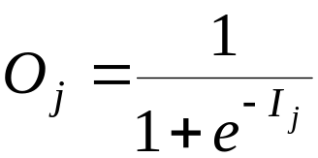
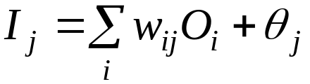
Multi-Layer Perceptron
Output vector
Output nodes
Hidden nodes
w_{ij}
Input nodes
Input vector: x_{i}

Slide 64
Network Pruning and Rule Extraction
Network pruning
  Fully connected network will be hard to articulate
  N input nodes, h hidden nodes and m output nodes lead to h(m+N) weights
  Pruning: Remove some of the links without affecting classification accuracy of the network
Extracting rules from a trained network
  Discretize activation values; replace individual activation value by the cluster average maintaining the network accuracy
  Enumerate the output from the discretized activation values to find rules between activation value and output
  Find the relationship between the input and activation value
  Combine the above two to have rules relating the output to input

Slide 65
Classification and Prediction
What is classification? What is prediction?
Issues regarding classification and prediction
Classification by decision tree induction
Bayesian Classification
Classification by backpropagation
Classification based on concepts from association rule mining
Other Classification Methods
Prediction
Classification accuracy
Summary

Slide 66
Association-Based Classification
Several methods for association-based classification
  ARCS: Quantitative association mining and clustering of association rules (Lent et al’97)
    It beats C4.5 in (mainly) scalability and also accuracy
  Associative classification: (Liu et al’98)
    It mines high support and high confidence rules in the form of “cond_set => y”, where y is a class label
  CAEP (Classification by aggregating emerging patterns) (Dong et al’99)
    Emerging patterns (EPs): the itemsets whose support increases significantly from one class to another
    Mine Eps based on minimum support and growth rate

Slide 67
Mining Quantitative Association Rules
Numeric attributes are dynamically discretized during the
mining process so as to satisfy some mining criteria, such that
the confidence or compactness of the rules mined is
maximized.
2-D quantitative association rules:
A_{quan1} ∧ A_{quan2} ⇒ A_{cat} (two dimensional quantitative association rules).
We can mine such rules by ARCS ( association rule clustering
system).
Example:
age(X,”30-34”) ∧ income(X,”24K - 48K”) ⇒ buys(X,”high resolution TV”)

Slide 68

A 2-D grid for tuples representing customers who purchase high resolution TVs

Slide 69
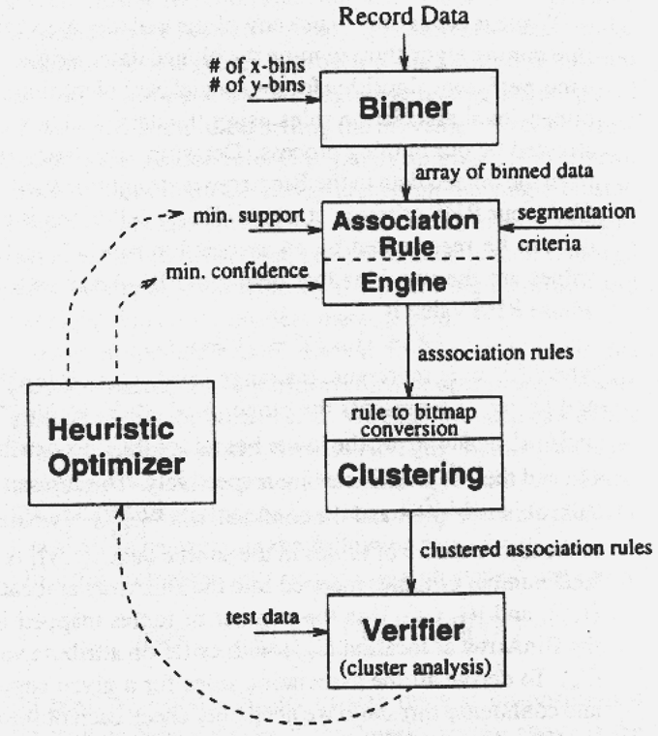
ARCS (Association Rule Clustering System)
How does ARCS work?
1. Binning
2. Find frequent predicate set
3. Clustering
4. Optimize

Slide 70
ARCS
Binning: To keep the grids in a manageable size, we partition the ranges of quantitative attributes into intervals.
These intervals are dynamic that may further be combined during the mining process.
This partitioning process is referred to as binning, where intervals are considered as “bins”. Three binning strategies are:
  Equiwidth : where the interval size of each bin is same.
  Equidepth : where each bin has approximately the same no. of tuples assigned to it.
  Homogeneity based binning : where bin size is determined so that the tuples are uniformly distributed in each bin.
  ARCS uses equi-width binning, where bin size for each quantitative attribute is input by the user.
  A 2-D array can be used to generate rules for any value of the categorical attribute, based on the two quantitative attributes.

Slide 71
Finding Frequent predicate sets :
Once 2-D array containing the count distribution for each category is set up, frequent predicate sets are found out (that satisfy min_support) and also which satisfy min_confidence.
Strong association rules can be generated from these predicate sets using rule generation algo.

Slide 72
Clustering the Association rule:
Association Rules obtained in the previous step are mapped to a 2-D grid.
Given the rules,
Age(X,34)^income(X,”31k…40k)=>buys(X, “high resolution TV”)
Age(X,35)^income(X,”31k…40k)=>buys(X, “high resolution TV”)
Age(X,34)^income(X,”41k…50k)=>buys(X, “high resolution TV”)
Age(X,35)^income(X,”41k…50k)=>buys(X, “high resolution TV”)
The above rules can be clustered & replaced
Age(X,34..35)^income(X,”31k…50k”)=>buys(X, “high resolution TV”)
ARCS employs a clustering algorithm that scans the grid, searching for rectangular clusters of rules.
Grid based techniques assumes that the initial association rules can be clustered.
Prior to clustering, smoothing techniques can be used to remove noise and outliers.

Slide 73
Limitations of ARCS
Only quantitative attributes on LHS of rules.
Only 2 attributes on LHS. (2D limitation)
An alternative to ARCS
  Non-grid-based
  equi-depth binning
  clustering based on a measure of partial completeness.

Slide 74
Classification and Prediction
What is classification? What is prediction?
Issues regarding classification and prediction
Classification by decision tree induction
Bayesian Classification
Classification by backpropagation
Classification based on concepts from association rule mining
Other Classification Methods
Prediction
Classification accuracy
Summary

Slide 75
Other Classification Methods
k-nearest neighbor classifier
case-based reasoning
Genetic algorithm
Rough set approach
Fuzzy set approaches

Slide 76
Instance-Based Methods
Instance-based learning:
  Store training examples and delay the processing (“lazy evaluation”) until a new instance must be classified
Typical approaches
  k-nearest neighbor approach
    Instances represented as points in a Euclidean space.
  Locally weighted regression
    Constructs local approximation
  Case-based reasoning
    Uses symbolic representations and knowledge-based inference

Slide 77
The k-Nearest Neighbor Algorithm
The k-nearest-neighbor method was first described in the early 1950s. The method is labor intensive when given large training sets, and did not gain popularity until the 1960s
when increased computing power became available. It has since been widely used in the area of pattern recognition.
Nearest-neighbor classifiers are based on learning by analogy, that is, by comparing a given test tuplewith training tuples that are similar to it. The training tuples are described by n attributes.
Each tuple represents a point in an n-dimensional space.
In this way, all of the training tuples are stored in an n-dimensional pattern space.

Slide 78

When given an unknown tuple, a k-nearest-neighbor classifier searches the pattern space for the k training tuples that are closest to the unknown tuple.
These k training tuples are the k “nearest neighbors” of the unknown tuple.
“Closeness” is defined in terms of a distance metric, such as Euclidean distance.
The Euclidean distance between two points or tuples, say, X1 = (x11, x12, : : : , x1n) and X2 = (x21, x22, : : : , x2n), is

Slide 79
For k-nearest-neighbor classification, the unknown tuple is assigned the most common class among its k nearest neighbors.
When k = 1, the unknown tuple is assigned the class of the training tuple that is closest to it in pattern space.
Nearest neighbor classifiers can also be used for prediction, that is, to return a real-valued prediction for a given unknown tuple.

Slide 80
Remarks on Lazy vs. Eager Learning
Instance-based learning: lazy evaluation
Decision-tree and Bayesian classification: eager evaluation
Key differences
  Lazy method may consider query instance xq when deciding how to generalize beyond the training data D
  Eager method cannot since they have already chosen global approximation when seeing the query
Efficiency: Lazy - less time training but more time predicting
Accuracy
  Lazy method effectively uses a richer hypothesis space since it uses many local linear functions to form its implicit global approximation to the target function
  Eager: must commit to a single hypothesis that covers the entire instance space

Slide 81
Case-Based Reasoning
Case-based reasoning (CBR) classifiers use a database of problem solutions to solve new problems. Unlike nearest-neighbor classifiers, which store training tuples as points in Euclidean space, CBR stores the tuples or “cases” for problem solving as complex symbolic descriptions.
Business applications of CBR include problem resolution for customer service help desks, where cases describe product-related diagnostic problems.
CBR has also been applied to areas such as engineering and law, where cases are either technical designs or legal rulings, respectively.
Medical education is another area for CBR, where patient case histories and treatments are used to help diagnose and treat new patients.

Slide 82
When given a new case to classify, a case-based reasoner will first check if an identical training case exists. If one is found, then the accompanying solution to that case is returned.
If no identical case is found, then the case-based reasoner will search for training cases having components that are similar to those of the new case.
Conceptually, these training cases may be considered as neighbors of the new case.
If cases are represented as graphs, this involves searching for subgraphs that are similar to subgraphs within the new case.
The case-based reasoner tries to combine the solutions of the neighboring training cases in order to propose a solution for the new case.
If incompatibilities arise with the individual solutions, then backtracking to search for other solutions may be necessary.
The case-based reasoner may employ background knowledge and problem-solving strategies in order to propose a feasible combined solution

Slide 83
Challenges in case-based reasoning include finding a good similarity metric (e.g., for matching subgraphs) and suitable methods for combining solutions.
Other challenges include the selection of salient features for indexing training cases and the development of efficient indexing techniques.
A trade-off between accuracy and efficiency evolves as the number of stored cases becomes very large. As this number increases, the case-based reasoner becomes more intelligent.
After a certain point, however, the efficiency of the system will suffer as the time required to search for and process relevant cases increases.
As with nearest-neighbor classifiers, one solution is to edit the training database. Cases that are redundant or that have not proved useful may be discarded for the sake of improved performance.
These decisions, however, are not clear-cut and their automationremains an active area of research.

Slide 84
Genetic Algorithms
GA: based on an analogy to biological evolution
Each rule is represented by a string of bits
An initial population is created consisting of randomly generated rules
  e.g., IF A₁ and Not A₂ then C₂ can be encoded as 100
Based on the notion of survival of the fittest, a new population is formed to consists of the fittest rules and their offspring
The fitness of a rule is represented by its classification accuracy on a set of training examples
Offspring are generated by applying genetic operators such as crossover and mutation.
In crossover, substrings from pairs of rules are swapped to form new pairs of rules.
In mutation, randomly selected bits in a rule’s string are inverted.
The process of generating new populations based on prior populations of rules continues until a population P “evolves” where each rule in P satisfies a prespecified fitness threshold.

Slide 85
Rough Set Approach
Rough set theory can be used for classification to discover structural relationships within imprecise or noisy data. It applies to discrete-valued attributes.
Continuous-valued attributes must therefore be discretized before its use.
Rough set theory is based on the establishment of equivalence classes within the given training data.
All of the data tuples forming an equivalence class are indiscernible, that is, the samples are identical with respect to the attributes describing the data.
Given real world data, it is common that some classes cannot be distinguished in terms of the available attributes.
Rough sets can be used to approximately or “roughly” define such classes.

Slide 86

Rough Set Approach
A rough set for a given class C is approximated by two sets: a lower approximation (certain to be in C) and an upper approximation (cannot be described as not belonging to C)
The lower approximation of C consists of all of the data tuples that, based on the knowledge of the attributes, are certain to belong to C without ambiguity.
The upper approximation of C consists of all of the tuples that, based on the knowledge of the attributes, cannot be described as not belonging to C.
Rough sets can also be used for attribute subset selection (or feature reduction, where attributes that do not contribute toward the classification of the given training data can be identified and removed) and relevance analysis (where the contribution or significance of each attribute is assessed with respect to the classification task).

Slide 87
Fuzzy Set Approaches
Rule-based systems for classification have the disadvantage that they involve sharp cutoffs for continuous attributes.
For example, consider the following rule for customer credit application approval.
The rule essentially says that applications for customers who have had a job for two or more years and who have a high income (i.e., of at least $50,000) are approved:
IF (years employed 2) AND (income 50K) THEN credit = approved
By Rule, a customer who has had a job for at least two years will receive credit if her income is, say, $50,000, but not if it is $49,000. Such harsh thresholding may seem unfair.

Slide 88
Instead, we can discretize income into categories such as (low income, medium income, high income), and then apply fuzzy logic to allow “fuzzy” thresholds or boundaries to be defined for each category
Rather than having a precise cutoff between categories, fuzzy logic uses truth values between 0:0 and 1:0 to represent the degree of membership that a certain value has in a given category. Each category then represents a fuzzy set.
Hence, with fuzzy logic, we can capture the notion that an income of $49,000 is, more or less, high, although not as high as an income of $50,000.
Fuzzy logic systems typically provide graphical tools to assist users in converting attribute values to fuzzy truth vlaues.

Slide 89
Most important, fuzzy set theory allows us to dealwith vague or inexact facts.
For example, being a member of a set of high incomes is inexact (e.g., if $50,000 is high, then what about $49,000? Or $48,000?) Unlike the notion of traditional “crisp” sets where an element either belongs to a set S or its complement, in fuzzy set theory, elements can belong to more than one fuzzy set.
For example, the income value $49,000 belongs to both the medium and high fuzzy sets, but to differing degrees.
Using fuzzy set notation and following Figure, this can be shown as
mmedium income($49K) = 0:15 and mhigh income($49K) = 0:96,
where m denotes the membership function, operating on the fuzzy sets of medium income and high income, respectively.

Slide 90

Fuzzy Set Approaches
Fuzzy logic uses truth values between 0.0 and 1.0 to represent the degree of membership (such as using fuzzy membership graph)
Attribute values are converted to fuzzy values
  e.g., income is mapped into the discrete categories {low, medium, high} with fuzzy values calculated
For a given new sample, more than one fuzzy value may apply
Each applicable rule contributes a vote for membership in the categories
Typically, the truth values for each predicted category are summed

Slide 91
Classification and Prediction
What is classification? What is prediction?
Issues regarding classification and prediction
Classification by decision tree induction
Bayesian Classification
Classification by backpropagation
Classification based on concepts from association rule mining
Other Classification Methods
Prediction
Classification accuracy
Summary

Slide 92
What Is Prediction?
Prediction is similar to classification
  First, construct a model
  Second, use model to predict unknown value
    Major method for prediction is regression
      Linear and multiple regression
      Non-linear regression
Prediction is different from classification
  Classification refers to predict categorical class label
  Prediction models continuous-valued functions

Slide 93
Predictive Modeling in Databases
Predictive modeling: Predict data values or construct generalized linear models based on the database data.
One can only predict value ranges or category distributions
Method outline:
  Minimal generalization
  Attribute relevance analysis
  Generalized linear model construction
  Prediction
Determine the major factors which influence the prediction
  Data relevance analysis: uncertainty measurement, entropy analysis, expert judgement, etc.
Multi-level prediction: drill-down and roll-up analysis

Slide 94
Regress Analysis and Log-Linear Models in Prediction
Linear regression: Y = α + β X
  Two parameters , α and β specify the line and are to be estimated by using the data at hand.
  using the least squares criterion to the known values of Y1, Y2, …, X1, X2, ….
Multiple regression: Y = b0 + b1 X1 + b2 X2.
  Many nonlinear functions can be transformed into the above.
Log-linear models:
  The multi-way table of joint probabilities is approximated by a product of lower-order tables.
  Probability: p(a, b, c, d) = αab βacχad δbcd

Slide 95
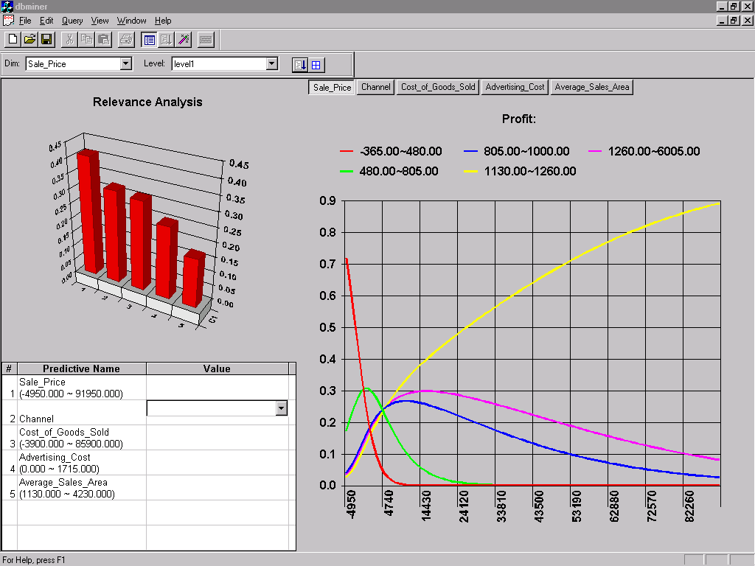
Prediction: Numerical Data

Slide 96
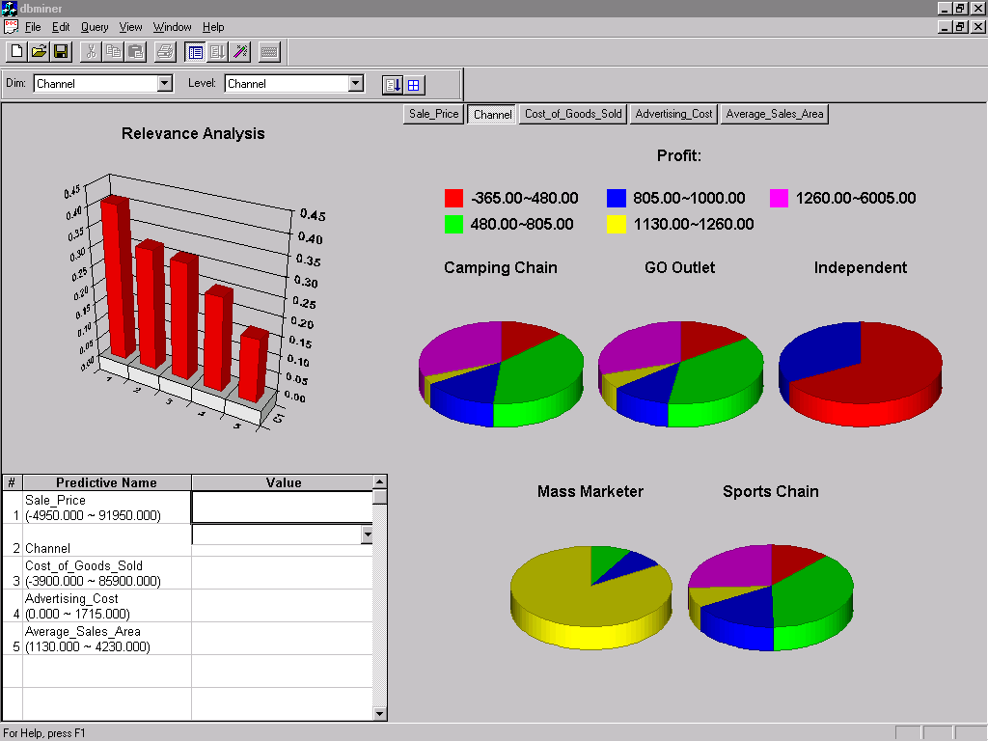
Prediction: Categorical Data

Slide 97
Classification and Prediction
What is classification? What is prediction?
Issues regarding classification and prediction
Classification by decision tree induction
Bayesian Classification
Classification by backpropagation
Classification based on concepts from association rule mining
Other Classification Methods
Prediction
Classification accuracy
Summary

Slide 98
Classifier Accuracy
Estimating classifier accuracy is important in that it allows one to evaluate how accurately a given classifier will label future data, that is, data on which the classifier has not been trained.
For example, suppose you used data from previous sales to train a classifier to predict customer purchasing behavior.
You would like an estimate of how accurately the classifier can predict the purchasing behavior of future customers, that is, future customer data on which the classifier has not been trained.
Accuracy estimates to help in the comparison of different classifiers.
We can use these measures in techniques for accuracy estimation, such as the holdout, random subsampling, k-fold cross-validation, and bootstrap methods

Slide 99
Estimating Classifier Accuracy
The holdout method is what we have alluded to so far in our discussions about accuracy.
In this method, the given data are randomly partitioned into two independent sets, a training set and a test set. Typically, two-thirds of the data are allocated to the training set, and the remaining one-third is allocated to the test set.
The training set is used to derive the model, whose accuracy is estimated with the test set
The estimate is pessimistic because only a portion of the initial data is used to derive the model.
Random subsampling is a variation of the holdout method in which the holdout method is repeated k times.
The overall accuracy estimate is taken as the average of the accuracies obtained from each iteration. (For prediction, we can take the average of the predictor error rates.)

Slide 100
Holdout Method and Random Subsampling
The holdout method is what we have alluded to so far in our discussions about accuracy.
In this method, the given data are randomly partitioned into two independent sets, a training set and a test set.
Typically, two-thirds of the data are allocated to the training set, and the remaining one-third is allocated to the test set.
The training set is used to derive the model, whose accuracy is estimated with the test set .

Slide 101
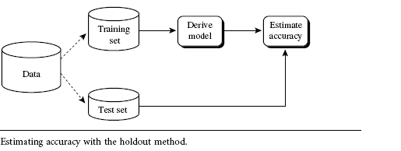
The estimate is pessimistic because only a portion of the initial data is used to derive the model.
Random sub sampling is a variation of the holdout method in which the holdout method is repeated k times.
The overall accuracy estimate is taken as the average of the accuracies obtained from each iteration. (For prediction, we can take the average of the predictor error rates.)

Slide 102
Cross-validation
In k-fold cross-validation, the initial data are randomly partitioned into k mutually exclusive subsets or “folds,” D1, D2, : : : , Dk, each of approximately equal size.
Training and testing is performed k times. In iteration i, partition Di is reserved as the test set, and the remaining partitions are collectively used to train the model.
That is, in the first iteration, subsets D2, : : : , Dk collectively serve as the training set in order to obtain a first model, which is tested on D1; the second iteration is trained on subsets D1, D3, : : : , Dk and tested on D2; and so on. Unlike the holdout and random subsampling methods above, here, each sample is used the same number of times for training and once for testing.
For classification, the accuracy estimate is the overall number of correct classifications from the k iterations, divided by the total number of tuples in the initial data. For prediction, the error estimate can be computed as the total loss from the k iterations, divided by the total number of initial tuples.

Slide 103
Bootstrap
Unlike the accuracy estimation methods mentioned above, the bootstrap method samples the given training tuples uniformly with replacement.
That is, each time a tuple is selected, it is equally likely to be selected again and readded to the training set.
For instance, imagine a machine that randomly selects tuples for our training set. In sampling with replacement, the machine is allowed to select the same tuple more than once

Slide 104
Ensemble Methods—Increasing the Accuracy
Are there general strategies for improving classifier and predictor accuracy?
YES, Bagging and boosting are two such techniques.
We first take an intuitive look at how bagging works as a method of increasing accuracy.
For ease of explanation, we will assume at first that our model is a classifier. Suppose that you are a patient and would like to have a diagnosis made based on your symptoms.
Instead of asking one doctor, you may choose to ask several. If a certain diagnosis occurs more than any of the others, you may choose this as the final or best diagnosis.
That is, the final diagnosis is made based on a majority vote, where each doctor gets an equal vote. Now replace each doctor by a classifier, and you have the basic idea behind bagging.
Intuitively, a majority vote made by a large group of doctors may be more reliable than a majority vote made by a small group.

Slide 105
Given a set, D, of d tuples, bagging works as follows.
For iteration i (i = 1, 2, : : : , k), a training set,Di, of d tuples is sampled with replacement from the original set of tuples,D.
Note that the term bagging stands for bootstrap aggregation.
A classifier model, Mi, is learned for each training set, Di.
To classify an unknown tuple, X, each classifier, Mi, returns its class prediction, which counts as one vote.
The bagged classifier, M, counts the votes and assigns the class with the most votes to X.
Bagging can be applied to the prediction of continuous values by taking the average value of each prediction for a given test tuple.
The bagged classifier often has significantly greater accuracy than a single classifier derived from D, the original training data.

Slide 106
Boosting
We now look at the ensemble method of boosting. As in the previous section, suppose that as a patient, you have certain symptoms.
Instead of consulting one doctor, you choose to consult several. Suppose you assign weights to the value or worth of each doctor’s diagnosis, based on the accuracies of previous diagnoses they have made.
The final diagnosis is then a combination of the weighted diagnoses. This is the essence behind boosting.

Slide 107
In boosting, weights are assigned to each training tuple.
A series of k classifiers is iteratively learned. After a classifier Mi is learned, the weights are updated to allow the subsequent classifier,Mi+1, to “pay more attention” to the training tuples that were misclassified by Mi.
The final boosted classifier, M, combines the votes of each individual classifier, where the weight of each classifier’s vote is a function of its accuracy.
The boosting algorithm can be extended for the prediction of continuous values

Slide 108
Classification Accuracy: Estimating Error Rates
Partition: Training-and-testing
  use two independent data sets, e.g., training set (2/3), test set(1/3)
  used for data set with large number of samples
Cross-validation
  divide the data set into k subsamples
  use k-1 subsamples as training data and one sub-sample as test data --- k-fold cross-validation
  for data set with moderate size
Bootstrapping (leave-one-out)
  for small size data

